Slide 1
Project 2: General Info

Slide 2
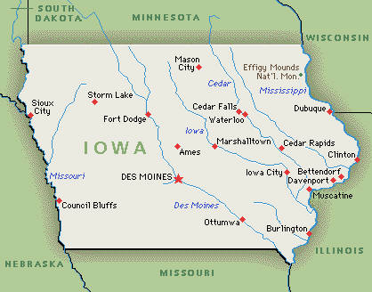
The Ames Home Sales Data Set

Slide 3
The original Ames Home Sales data set contains information about the sale of individual residential property in Ames, Iowa, from 2006 to 2010 including 2,930 observations and a 98 explanatory variables involved in assessing home values. In addition, some summary variables including the natural log of the sale price of the homes are created.

Slide 4
A subset of the full data set, for homes with normal sales conditions (to avoid analyzing foreclosure or distressed sales) and gross living area of 1,500 square feet or less (to focus on homes of modest size) is obtained.
Each team is given a dataset of 500 houses randomly selected from that subset. Your job is to analyze the data and provide me with your findings for each problem listed.

Slide 5
Documents
data fields.docx
This file contains data fields along with their length, label, format & informat in the original dataset
Project 2 -Problems.docx
This file contains the problems you are to address
Note that Part 2 will be posted by 4/27

Slide 6
Deliverables
Report – consisting of technical & non-technical sections, appendix with your SAS program (in which you will have the codes for all parts) , outputs, and references.
For each part before the corresponding SAS code, provide a statement within /* */ to describe for what the code is written.
For example: /* Part 1 – Prob 2: The following code generates plots and descriptive statistics for continuous variables */

Slide 7
Deliverables- con’t
Put your team # (that is given to you with the dataset) on the cover page of your report
Rename your SAS program with an extension of your team name # and submit it separately to the slot reserved in Blackboard
For example: proj2_team20 if your team # is 20

Slide 8
Deadlines
Part 1: Friday, 4/29 by 12:00pm
Part 2: Friday, 5/6 by 12:00pm
If a team misses to submit the report along with all the supplementary files by the deadline to the slot reserved on BB as well as a hardcopy to my office, all members on that team will receive a 0 ( i.e. zero), no exception to the rule

